Slide 1
Business Intelligence and Data Warehousing (ANL408)
- By Sabarish Nair

Slide 2
Recap from last week....
Data Explosion
Types of Data
Database and its type
Why do we need data warehouse?
What is a data warehouse?
Components of data warehouse
Software for data warehouse
Business Intelligence
BI Example
BI Process
BI Components
BI Tools
Practical example of BI

Slide 3
Data Warehouse Architecture
Three major data warehouse architecture types:
Enterprise or Centralized Architecture
Federated Architecture
Multi-Tiered Architecture

Slide 4
Enterprise/ Centralized Data warehouse
DSS
ETL
Metadata
OLAP
Centralized Data Warehouse
Web Browsers
Data Mining
Data Sources
Data Preparation
Middleware/ API
4

Slide 5
Benefits of Centralized Architecture
Unified Data Management System
360-degree view of company's operation
Easier data governance
Centralized and single point of control

Slide 6
Federated Data warehouse/ Single Department Data Mart
Metadata
DSS
Data Mart
ETL
OLAP
Metadata
Data Mart
Web Browsers
Metadata
Data Mart
Data Mining
Data Sources
Data Preparation
Middleware/ API
6

Slide 7
Benefits of Federated System
Flexibility and agility
Scalability
Enhanced collaboration and data sharing
Improved fault tolerance and resiliency
Governance and regulatory compliance

Slide 8
Multi-tiered Architecture
Data Mart
DSS
ETL
Metadata
Data Mart
OLAP
Data Warehouse
Web Browsers
Data Mart
Data Mining
Data Sources
Data Preparation
Middleware/ API
8

Slide 9
Benefits of Multi-tiered architecture
Scalability
Better Performance
Modularity
Security
Improved resource management
Easier Maintenance
Improved Reliability

Slide 10
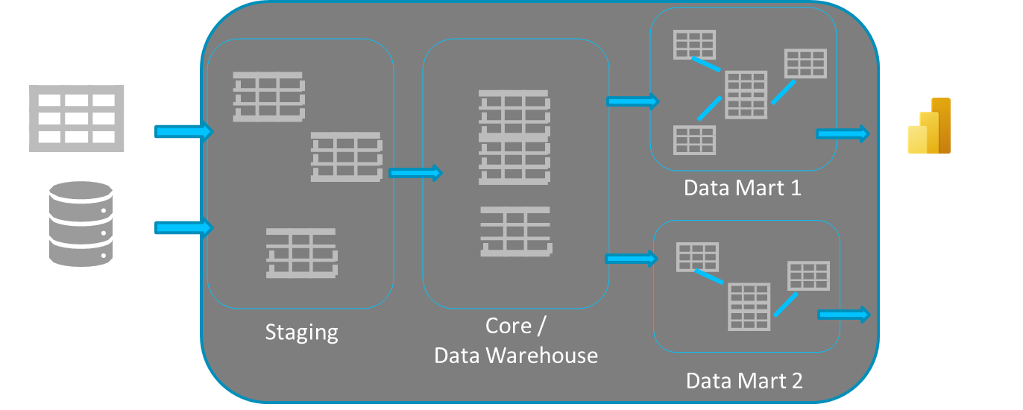
Layers of a data warehouse
Data Sources
DSS
10

Slide 11
Staging Layer
"A staging area, or landing zone, is an intermediate storage area used for data processing during the extract, transform, and load process."
"An intermediate area where raw data from various sources is initially loaded before being transformed and integrated into the data warehouse."

Slide 12
Staging area: Key Points
Data Ingestion
Data Cleansing
Data Transformation
Data Integration
Temporal Storage
Performance Optimization

Slide 13
Types: Staging Areas
Temporary
Persistent

Slide 14
Staging Area: Example 1 (Temporary vs Persistent Staging)
ID | Date | Name
1 | 03-02-2024 | Pen
2 | 03-02-2024 | Pencil
3 | 04-02-2024 | Pen
4 | 04-02-2024 | Pencil
ID | Date | Name
1 | 03-02-2024 | Pen
2 | 03-02-2024 | Pencil
3 | 04-02-2024 | Pen
4 | 04-02-2024 | Pencil
-- | -- | ----
ID | Date | Name
1 | 03-02-2024 | Pen
2 | 03-02-2024 | Pencil
3 | 04-02-2024 | Pen
4 | 04-02-2024 | Pencil
-- | -- | ----
Persistent Staging
Staging
ID | Date | Name
3 | 04-02-2024 | Pen
4 | 04-02-2024 | Pencil
-- | -- | ----
Input
Output
Temporary Staging

Slide 15
Staging Area: Example 2 (Combining Tables)
PID | Date | Name
1 | 03-02-2024 | Pen
2 | 03-02-2024 | Pencil
PID | Date | Name | SID
1 | 03-02-2024 | Pen | 1
2 | 03-02-2024 | Pencil | 2
Input 1: Product Information
Staging
SID | PID | Name | Location
1 | 1 | Lidl | Cork
2 | 2 | Dunnes | Dublin
Output
Input 2: Store Information

Slide 16
Staging Area: Example 3 (Merging Tables)
PID | Date | Name
1 | 03-02-2024 | Pen
2 | 03-02-2024 | Pencil
PID | Date | Name
1 | 03-02-2024 | Pen
2 | 03-02-2024 | Pencil
3 | 03-02-2024 | Ink
4 | 03-02-2024 | Rubber
Input 1: Product Information
Staging
PID | Date | Name
3 | 03-02-2024 | Ink
4 | 03-02-2024 | Rubber
Output
Input 2: Product Information

Slide 17
Summarizing Staging Layer
Landing Zone
Pulls data from multiple sources
Temporary or Persistent staging layers
Separate database

Slide 18
Data Mart
"A data mart is a specialized subset of a data warehouse focused on a specific functional area or department within an organization."
"Small-scale data warehouse that focuses on a specific business problem."

Slide 19
Data Mart: Example
Marketing
Marketing
Finance
Sales
Production
Finance
Data Mart
Sales
Production
Data warehouse
19

Slide 20
Data Mart: Characteristics
Restricted Scope
Usability
Closely match data requirements
Life cycle
Scope of coverage
Tool dependent

Slide 21
Types of Data Mart
Independent
Dependent
Hybrid

Slide 22
Data Mart: Advantages
Smaller Scope
Visualization
Closely match data requirements
Linked with other BI tools
Focused data
Improved Performance
Ease of use
Flexibility and scalability
Business Agility
Enhanced Security

Slide 23
Data Mart: Drawbacks
Limited Scope
Data Redundancy
Data Inconsistency
No common consolidates source
No common consolidated cleaning
Issue with cross data marts

Slide 24
Data Mart vs Data Warehouse
Data Warehouse | Data Mart
Centralized System | Decentralised system
Top- Down Model | Botton-Up Model
Long life | Shorter life
Vast Data | Smaller Data
Collects data from various sources | Collects data from warehouse
Optimum efficiency for business analysis | Faster response to requests and information

Slide 25


